Slide 1


Isaac A Abiola
February 05, 2025

Slide 2

Outline
Executive Summary
Introduction
Methodology
Results
Conclusion
Appendix

Slide 3
Executive Summary
We used 4 methods to predict the the probability of a success launch of a recock. The methods are the binary logistic regression model, support vector machine (SVM), Decision tree algorithm and k-nearest neighboor method.
In the data we examined we observed the following:
The predictive accuracy as measured by the score, of the binary logisic regression, the support vector machine, and the K-Nearest Neighbor model on the test data are the same. Thus none is preferred over the other in this study.
The confusion matrix of the three models are also the same which further reinforces the fact that the models performs similarly.
The tree model though easy to interprete and explain is not the preferred choice here because its performance in the test sample is not as good as the other models.
…

Slide 4
Introduction
Background
SpaceX is a private Space Exploration company. It designs, manufactures, and launches advanced rockets and spacecraft into various earth orbits. It competes with other companies in launching rockets/spacecrafts into orbits. The competitive advantage of SpaceX over its competitors is its ability to reuse the first stage of its Falcon 9 booster rockets, As such, based on this, SpaceX is in a position to quote lower launch price than its competitors, if they can reuse the captured booster from the launch.
Problem Statement
The business problems emanating from the above are as follows:
First SpaceX is interested in assessing and predicting the probability of capturing the first stage of Falcon 9 booster rocket following a launch into orbit.
Second, given the four launch sites they can launch from, they are interested in determining/identifying the launch site which is most likely to ensure a successful recapture of the booster rocket.

Slide 5

Section 1

Slide 6
Methodology
Executive Summary
Data collection methodology:
Describe how data was collected
Perform data wrangling
Describe how data was processed
Perform exploratory data analysis (EDA) using visualization and SQL
Perform interactive visual analytics using Folium and Plotly Dash
Perform predictive analysis using classification models
How to build, tune, evaluate classification models

Slide 7
Data Collection
Describe how data sets were collected.
Data was collected from sites on the internet using web scrapping applications
You need to present your data collection process use key phrases and flowcharts

Slide 8
Data Collection – SpaceX API
Github Link:
#1:
https://github.com/iabiola1979/Course-10----Applied-Data-Science-Capstone/blob/main/Course10_iaa.py
#2:
jupyter-labs-spacex-data-collection-api-v2_iaa.ipynb

Slide 9
Data Collection - Scraping
#1
https://github.com/iabiola1979/Course-10----Applied-Data-Science-Capstone/blob/main/Course10-Webscrapping.py
#2
https://github.com/iabiola1979/Course-10----Applied-Data-Science-Capstone/blob/main/jupyter-labs-webscraping_vscode.ipynb

Slide 10
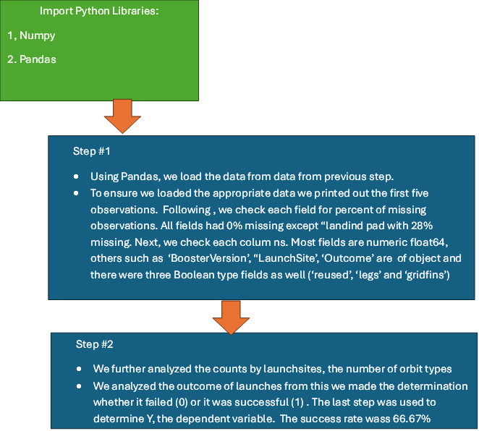
Data Wrangling
https://github.com/iabiola1979/Course-10----Applied-Data-Science-Capstone/blob/main/labs-jupyter-spacex-Data%20wrangling-v2.ipynb

Slide 11
EDA with Data Visualization
Summarize what charts were plotted and why you used those charts
Visualize the relationship between the following variables in the dataset: between Flight Number and Launch Site; between Payload and Launch Site; between success rate of each orbit type; between FlightNumber and Orbit type; between Payload and Orbit type; and rate the launch success yearly trend
https://github.com/iabiola1979/Course-10----Applied-Data-Science-Capstone/blob/main/jupyter-labs-eda-dataviz-v2.ipynb

Slide 12
EDA with SQL
Display the names of the unique launch sites in the space mission
CCAFS LC-40 26
CCAFS SLC-40 34
KSC LC-39A 25
VAFB SLC-4E 16
Display the total payload mass carried by boosters launched by NASA (CRS)
(619967,)
Display average payload mass carried by booster version F9 v1.1
6138.29
List the date when the first succesful landing outcome in ground pad was acheived.
'2015-12-22'
https://github.com/iabiola1979/Course-10----Applied-Data-Science-Capstone/blob/main/jupyter-labs-eda-sql-coursera_sqllite.ipynb

Slide 13
Build an Interactive Map with Folium
Mark all launch sites on the MAP of USA– Florida and California
Mark location with success/failure flags
Mark the launch site by closeness to the coastline, nearest railine and the closest city/town
https://github.com/iabiola1979/Course-10----Applied-Data-Science-Capstone/blob/main/lab-jupyter-launch-site-location-v2.ipynb

Slide 14
Build a Dashboard with Plotly Dash
Plotted a pie chart that shows the distribution of launches by launch sites
The second graph plots the relationship between the success rate and payload by the booster version
The pie chart is helpful is showing that the KSC LC 39A launch site produces the most successful launches.
https://github.com/iabiola1979/Course-10----Applied-Data-Science-Capstone/blob/main/Module10-DashboardExam.py

Slide 15
Predictive Analysis (Classification)
Import Python Libraries:
1, Numpy
2. Pandas
3.seaborn and
4 scikit-learn
Helper function leveraged
Plot_confusion_Matric()
https://github.com/iabiola1979/Course-10----Applied-Data-Science-Capstone/blob/main/SpaceX-Machine-Learning-Prediction-Part-5-v1.ipynb
Step #1
Using Pandas, we load the data from data from previous step.
To ensure we loaded the appropriate data we printed out the first five observations. Following , we check each field for percent of missing observations.
We then assign the fields into X, the independent variables ; and Y the dependent variable with 1/0 value. The X variable was scaled using Standard Scaler to normalize the input variables. Following, we then apply sklearn.train a-test_split to assign records into 80% training group and 20% test group
Step #2
We further analyzed the above data by running binary logistic regression , Support Vector classifier (SVC) model, decision tree model, and K-Nearest Neighbor model on the data. We used 10-fold cross to evaluate each of this model by evaluating their accuracy and confusion metrics.
Logistic REgression perform best with 10-fold cross valition score 87.5%

Slide 16
Results
Exploratory data analysis results
The plots indicate a significant relationship between payload mass a laund success with the most success from KSC LC -39A launchsite.
Interactive analytics demo in screenshots
Predictive analysis results
The binary logistic regression model is the most predictive. The cross validation score on test sample is 87.5%. Next are and the Support vector classification and KNN models each with 83.3% and the last is the tree model with score of 72.2% in test sample.
The confusion matrix however show that the binary logistic, SVM and KNN model have the same performance based on the confusion matrix.

Slide 17

Section 2

Slide 18
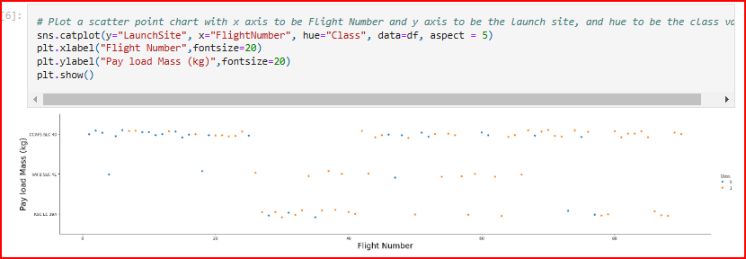
Flight Number vs. Launch Site

Slide 19
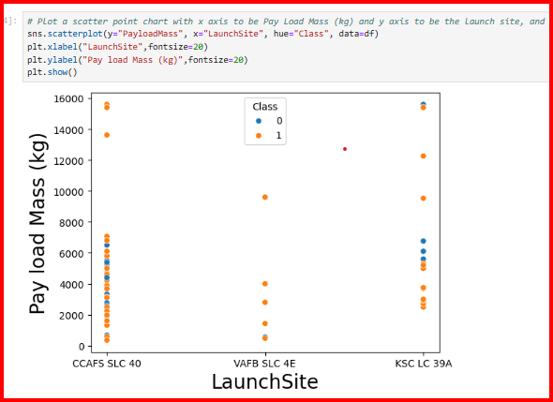
Payload vs. Launch Site

Slide 20
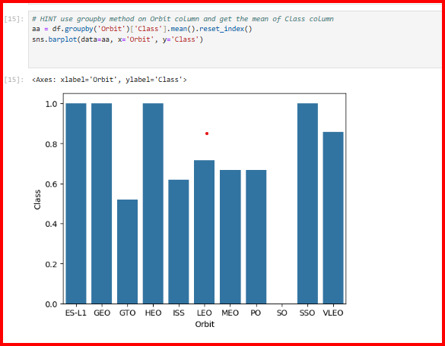
Success Rate vs. Orbit Type

Slide 21
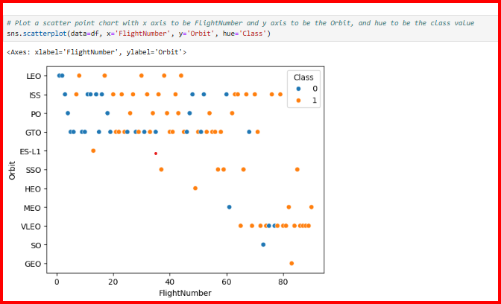
Flight Number vs. Orbit Type

Slide 22
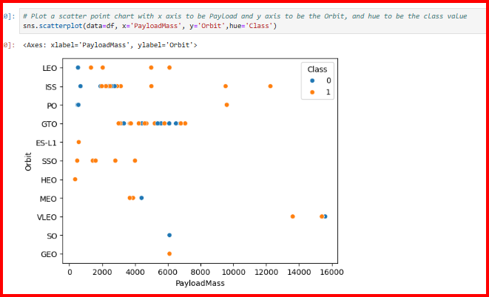
Payload vs. Orbit Type

Slide 23
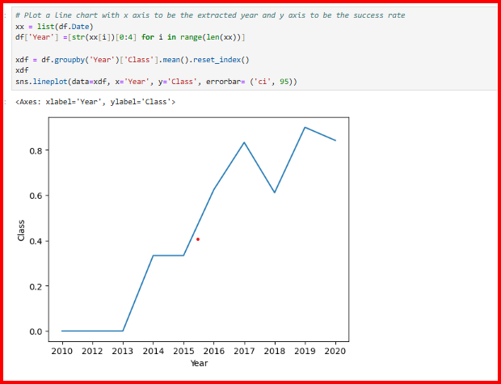
Launch Success Yearly Trend

Slide 24
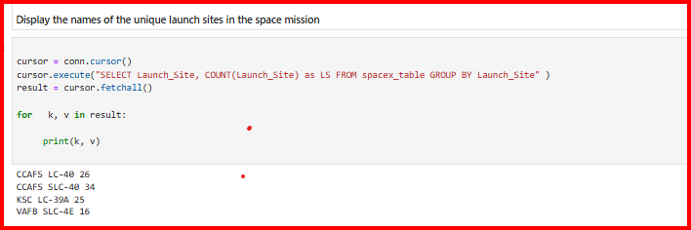
All Launch Site Names

Slide 25
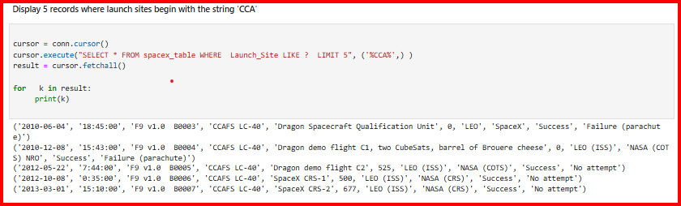
Launch Site Names Begin with 'CCA'

Slide 26
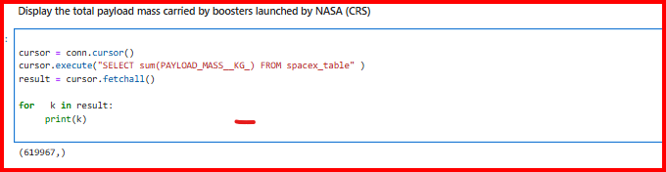
Total Payload Mass

Slide 27
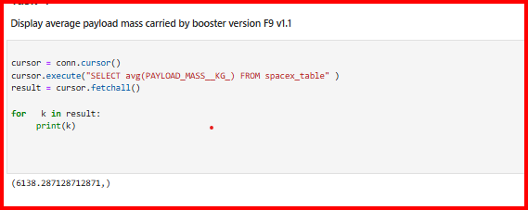
Average Payload Mass by F9 v1.1

Slide 28
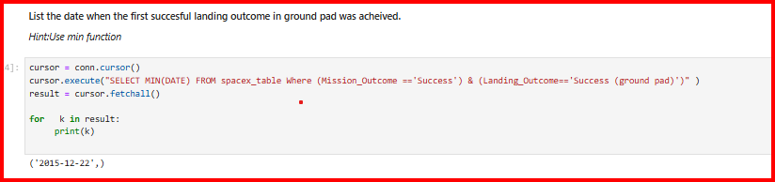
First Successful Ground Landing Date

Slide 29
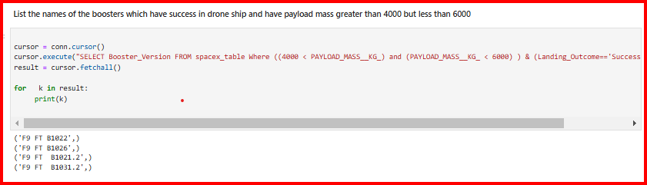
Successful Drone Ship Landing with Payload between 4000 and 6000

Slide 30
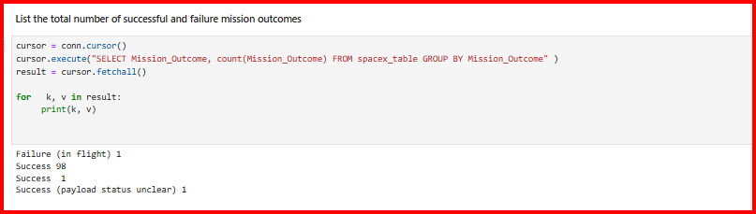
Total Number of Successful and Failure Mission Outcomes

Slide 31
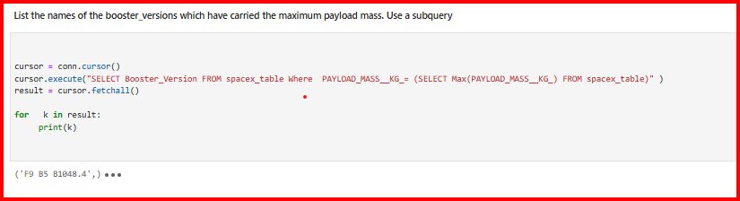
Boosters Carried Maximum Payload

Slide 32
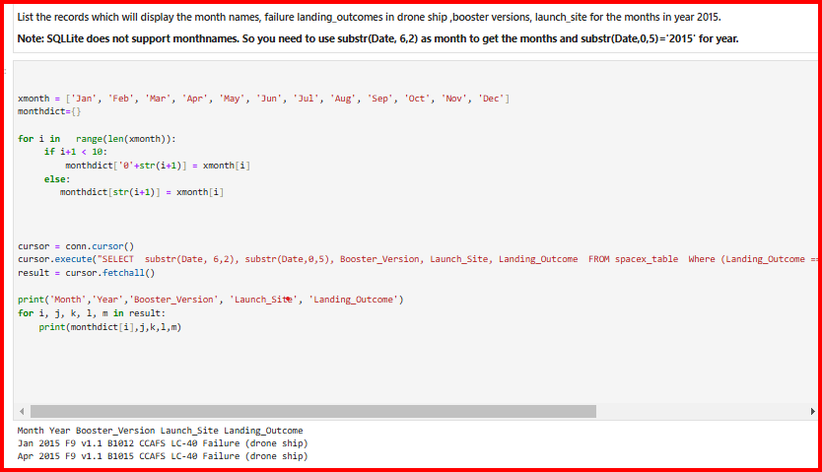
2015 Launch Records

Slide 33
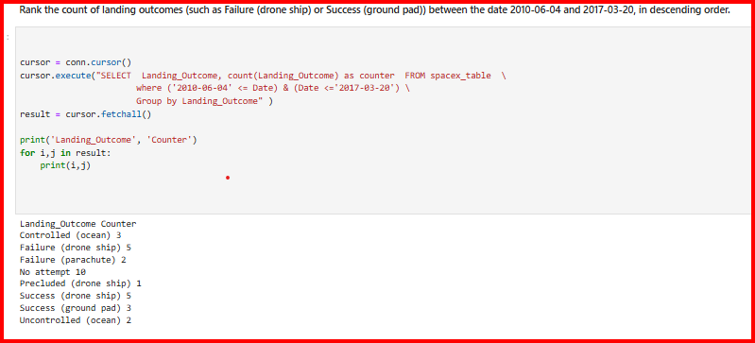
Rank Landing Outcomes Between 2010-06-04 and 2017-03-20

Slide 34

Section 3

Slide 35
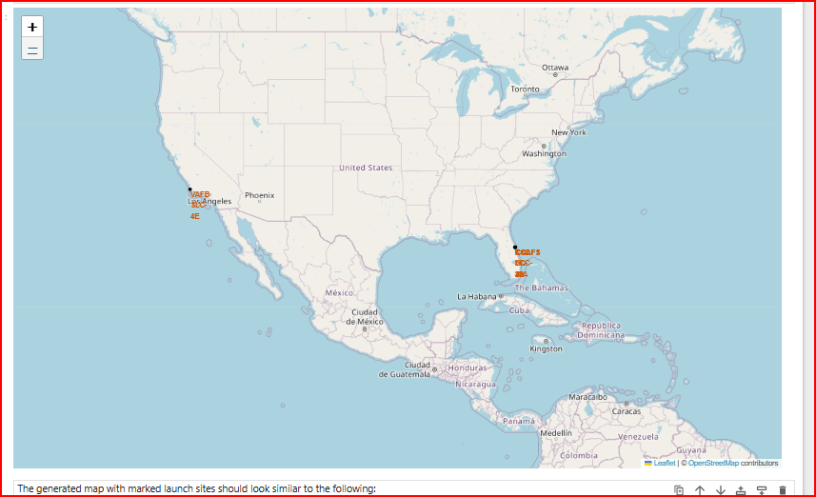
Falcon 9 Rockets Launch Sites
The four locations where Falcon 9 rockets are launched in California and Florida

Slide 36
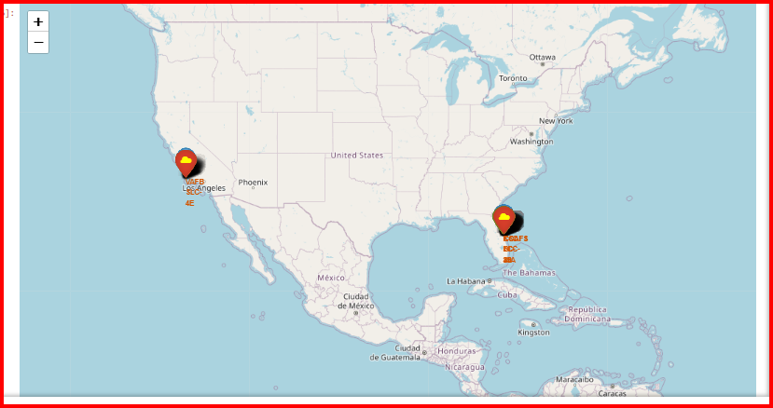
Launch Sites Marked with Success/Failures

Slide 37
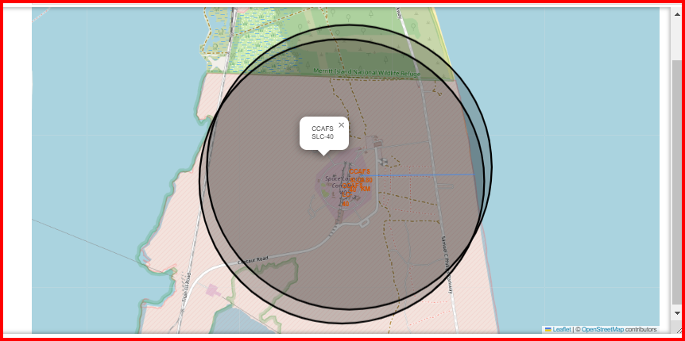
Launch Site Closeness to Facilities—Beach, Rail and Cities
Launch site proximities t0 railway, highway, coastline, with distance calculated and displayed
Launch site is about 9 miles to the beach and there is no city nearby.

Slide 38

Section 4

Slide 39
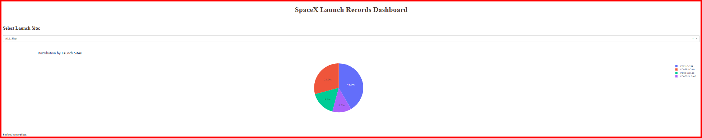
Launch Site Success Rate Distrinution
Show the screenshot of launch success count for all sites, in a piechart
KSC LC 39A is the best site for successful launch of all the available launch sites.

Slide 40
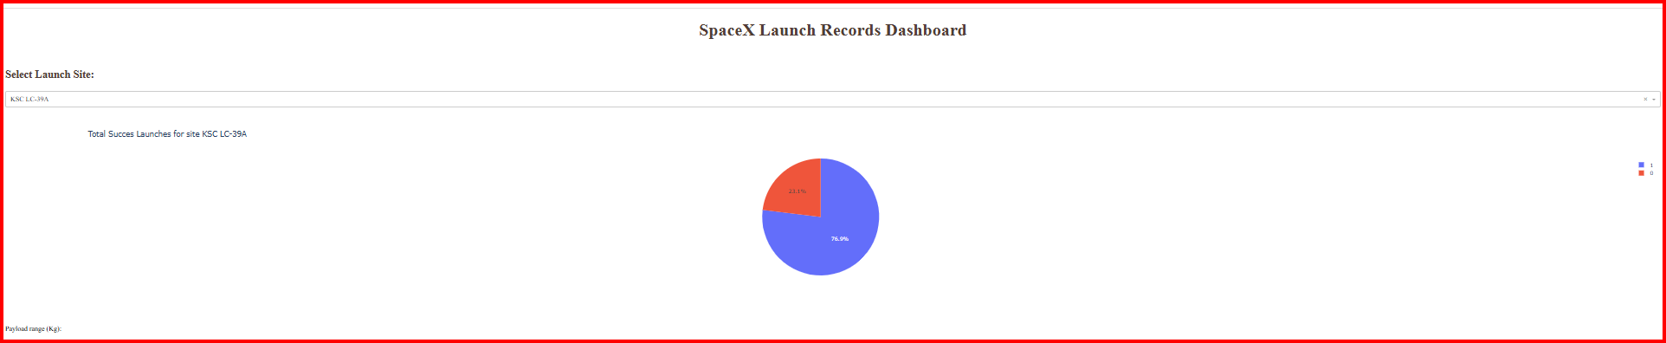
KSC LC -39A Launch Site Success Rate
Show the screenshot of the piechart for the launch site with highest launch success ratio
The site have a successful launch rate of 76.9%

Slide 41
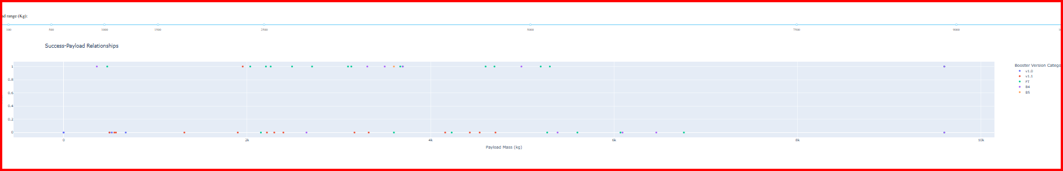
Successful Luanch – Payload Relationship by Rocket Type
The FT booster is the most successful given that most of the launches in reach orbit

Slide 42

Section 5

Slide 43
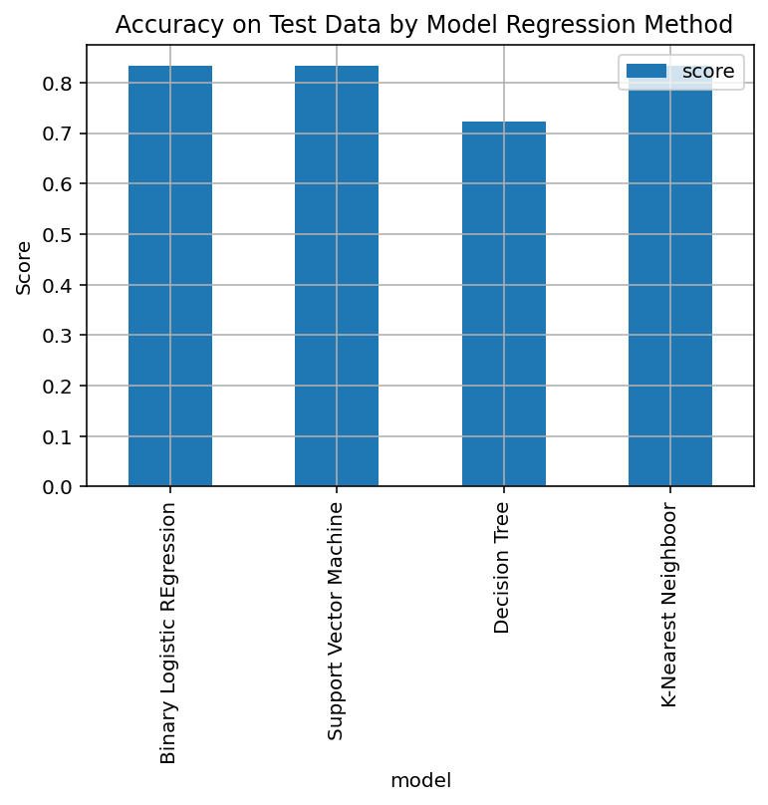
Classification Accuracy
Binary Logistic, Support Vector Machines and KNN Regression have the best accuracy. They are the tallest and the score value is the same at 83.3%.

Slide 44
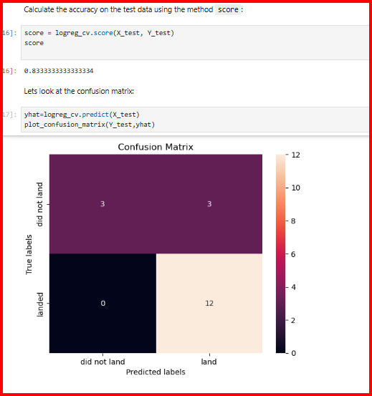
Confusion Matrix
The confusion matrix of logistic regression , SVM and KNN are similar. They also have the same score on the test sample.

Slide 45
Conclusions
The predictive accuracy as measured by the score, of the binary logisic regression, the support vector machine, and the K-Nearest Neighbor model on the test data are the same. Thus none is preferred over the other in this study.
The confusion matrix of the three models are also the same which further reinforces the fact that the models performs similarly.
The tree model though easy to interprete and explain is not the preferred choice here because its performance in the test sample is not as good as the other models.
…

Slide 46
Appendix
Include any relevant assets like Python code snippets, SQL queries, charts, Notebook outputs, or data sets that you may have created during this project

Slide 47


